Slide 2
Introduction to GPU Data Science Virtual Machine
Paul Shealy (Senior Software Engineer)
Gopi Kumar (Principal Program Manager)
Data Group,
Microsoft Corporation

Slide 3
Session Goals
Motivation for GPU
What are GPUs?
Why GPUs for deep learning?
Introduction to Azure GPU DSVMs
Understand the GPU hardware offering
Learn about DSVM
Scaling from one GPU to multiple GPUs
GPU Tools: Hands-on and demos
Notes:
This slide is required. Do NOT delete. This should be the first slide after your Title Slide.
This slide should describe what your goals are for this session. This information lets your audience know what you are trying to accomplish with your talk or tutorial—ie, what value will attendees get by investing 25 minutes or 2 hours of their time listening to you.
You should not spend more than 1 minute presenting this slide.
General examples of session goals could be (you will have to create your own specific goals):
Introduce a new technique or approach to solve a customer problem
Compare two approaches and explain why one is superior
Describe a project and the learnings that audience members can apply from it
Teach audience members how to use a specific technology

Slide 4
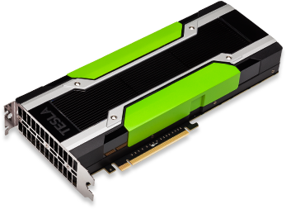
Motivation for GPUs

Slide 5
Why GPU?
Big Data, Simulation needs lots of raw computing
Single Core CPU performance limits
Multi Core CPUs still under 40 (mostly)
Solution:
Scale Out => Distributed Computing
Scale Up => Increase cores
GPUs
Long history with Graphic Acceleration
Extend to Compute Acceleration
Lots and Lots of Cores
Fast Vectorized Operations => SIMD

Slide 6
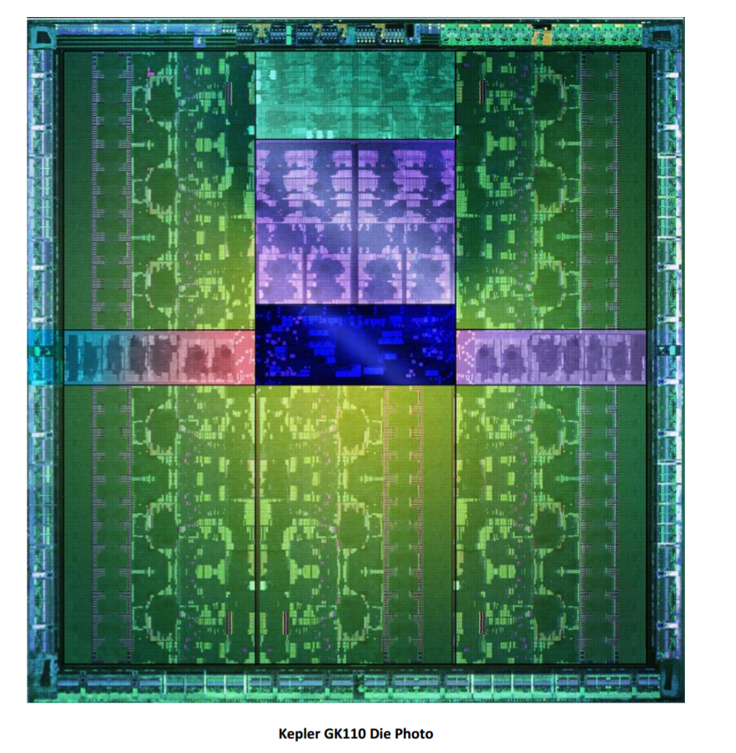
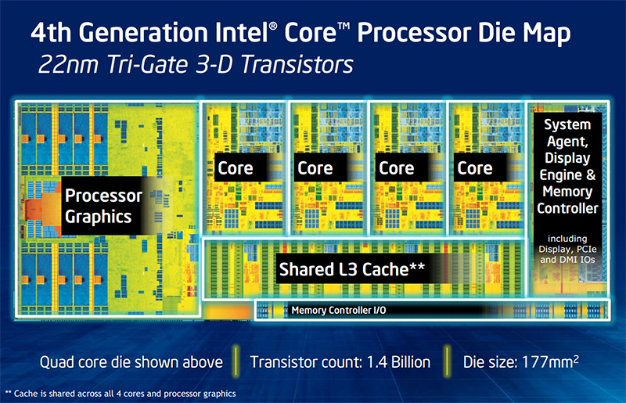

Slide 7
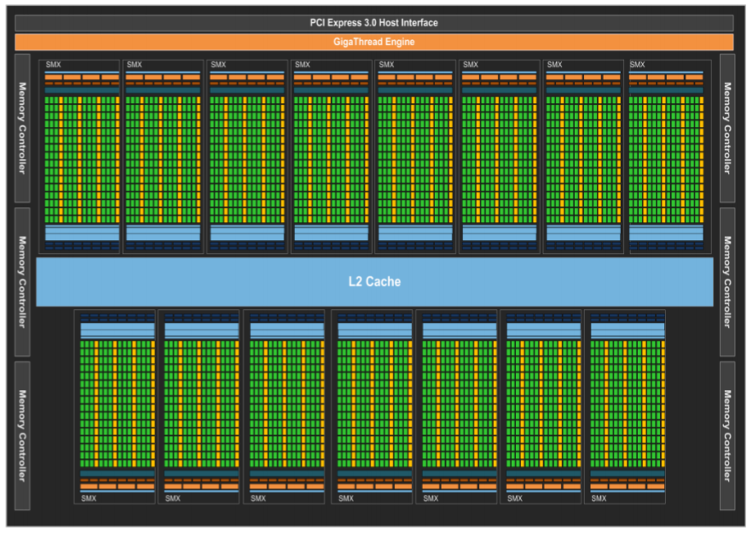

Slide 8
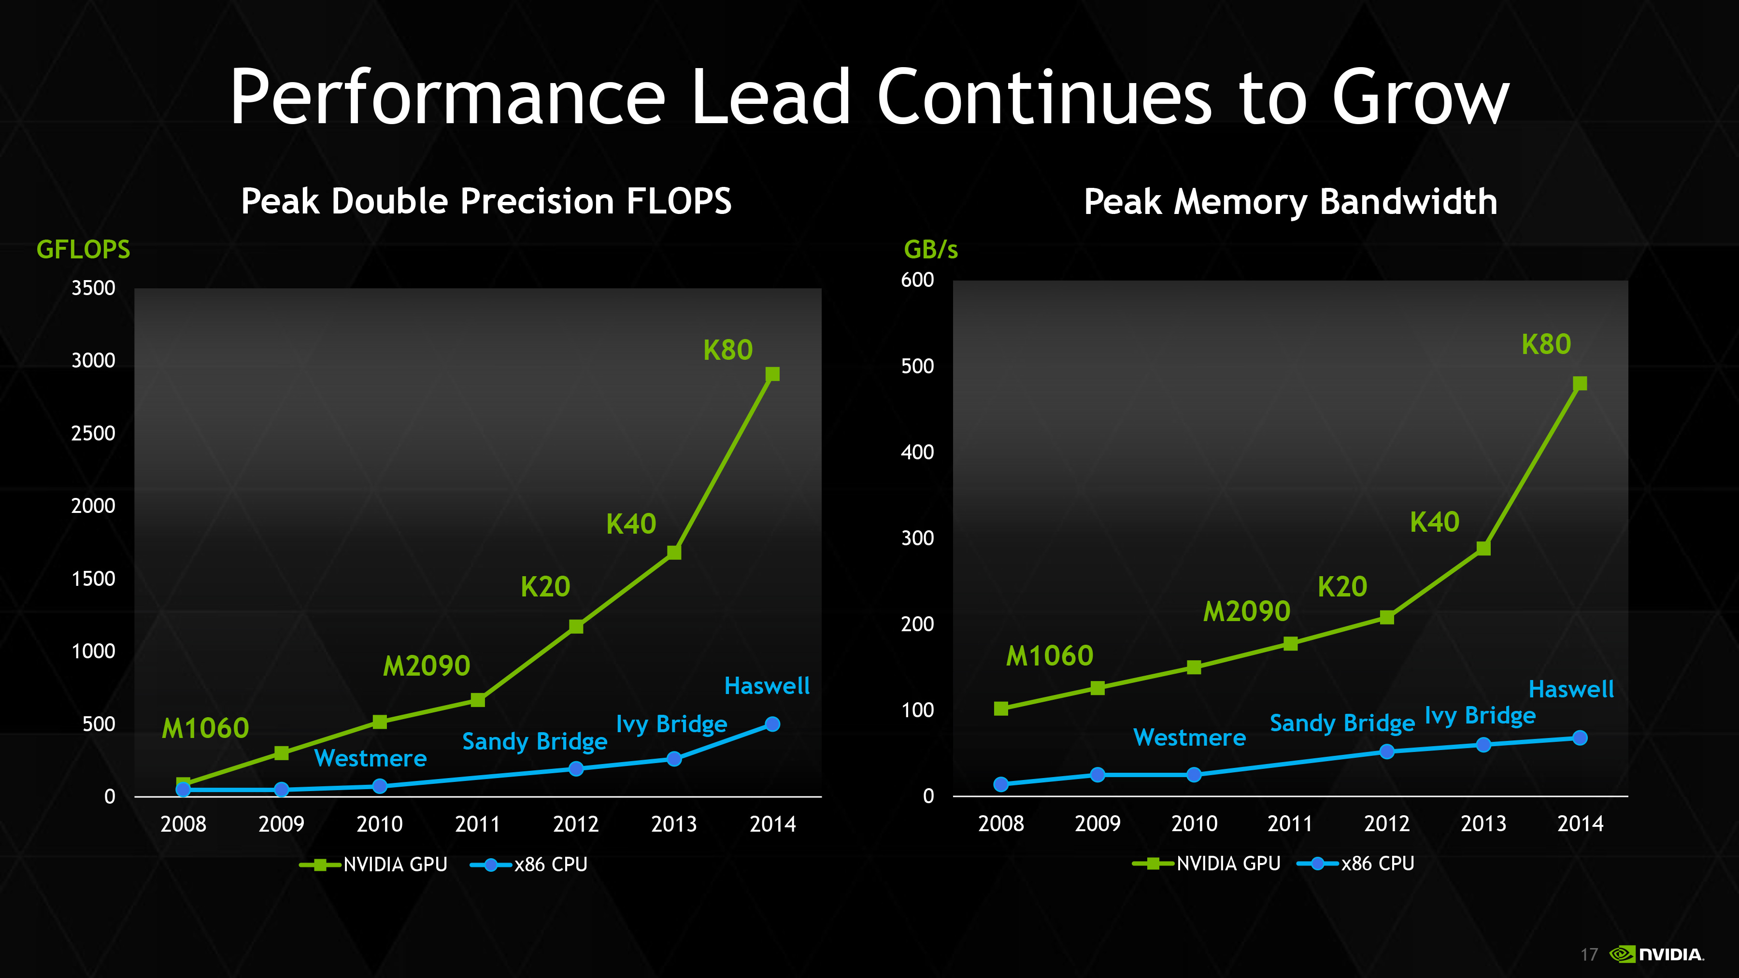

Slide 9
Leveraging the power of GPU
Direct GPU Programming
CUDA Toolkit
GPU Libraries
cuDNN, cuFFT, cuBLAS
GPU Accelerated Applications
CNTK, Microsoft ML, Tensorflow, Caffe etc.
Productivity
Control
Compute Acceleration unlike graphic acceleration is not transparent

Slide 10
Azure GPU Virtual Machines
 | NC6 | NC12 | NC24 | NC24r
Cores | 6 | 12 | 24 | 24
GPU | 1 K80 GPU (1/2 Physical Card) | 2 K80 GPUs (1 Physical Card) | 4 K80 GPUs (2 Physical Cards) | 4 K80 GPUs (2 Physical Cards)
Memory | 56 GB | 112 GB | 224 GB | 224 GB
Disk | ~380 GB SSD | ~680 GB SSD | ~1.5 TB SSD | ~1.5 TB SSD
Network | Azure Network | Azure Network | Azure Network | InfiniBand

Slide 11
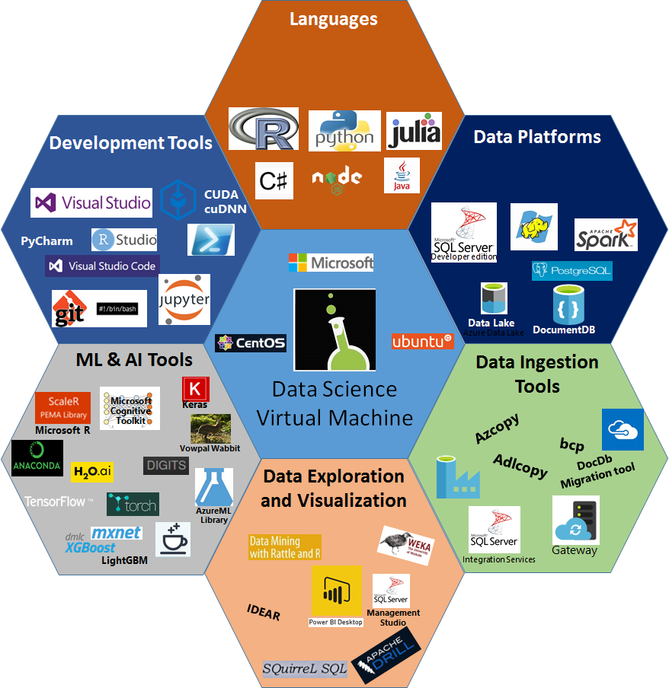
Data Science VM
Comprehensive cloud based Data Science Environment to empower Data Scientists

Slide 12
Hands-on and Demos
OpenCV
Single GPU
Multiple GPUs
Docker
DIGITS
TensorBoard

Slide 13
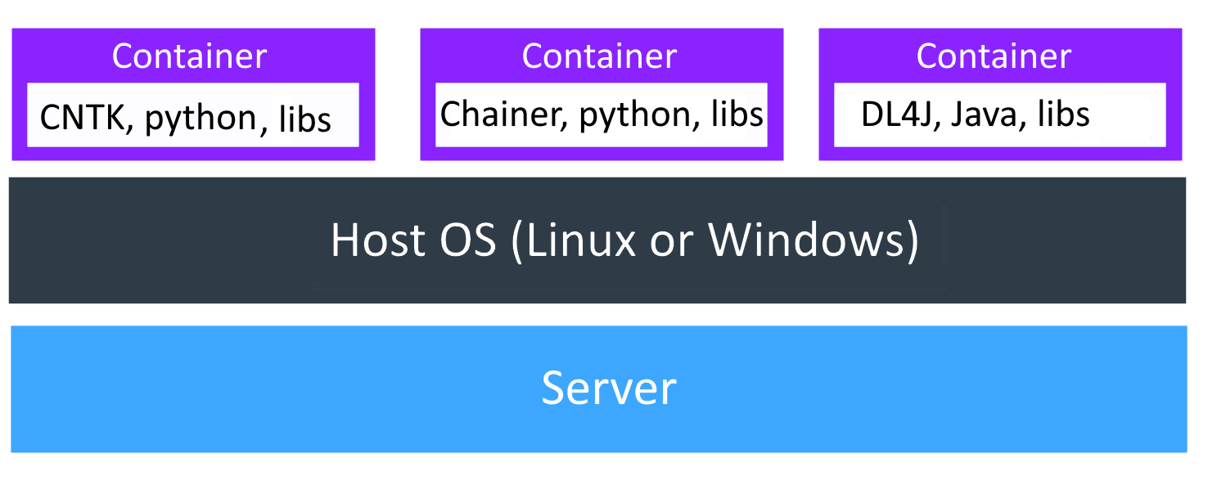
Docker
Lightweight containers (vs VMs)
Shared OS kernel
Provides resource isolation

Slide 14
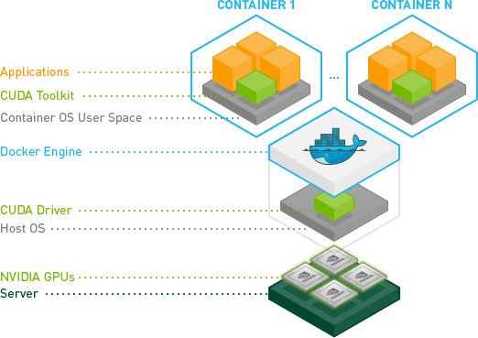
NVIDIA Docker
Container needs driver, GPU device(s)

Slide 15
References
DSVM Product Page
http://aka.ms/dsvm (Windows)
http://aka.ms/dsvm/deeplearning (Windows w/Deep Learning)
http://aka.ms/dsvm/ubuntu (Ubuntu)
2 Page Handout – http://aka.ms/dsvm/handout
DSVM Forum - send questions, feedback and feature requests on the forum - http://aka.ms/dsvm/forum
Learn Analytics @ Microsoft – http://learnanalytics.microsoft.com

